Slide 1
Agri-Tech-Farm Water Management

Slide 2
Problem Statement
This is a simple system to manage and actuate sprinklers based on soil temperature and moisture in a large farm.

Slide 3
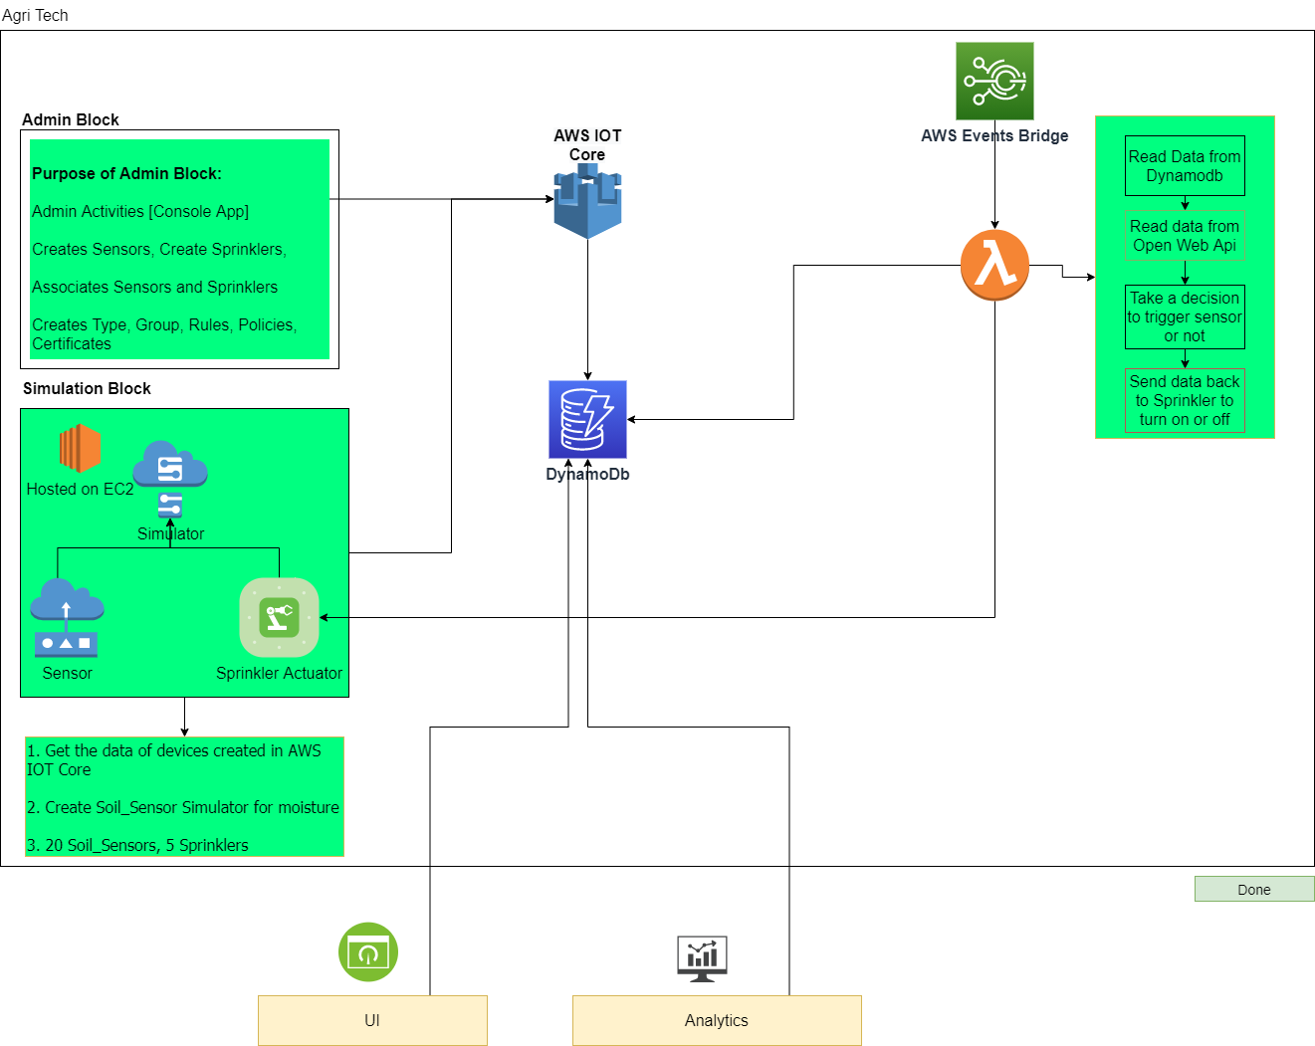
System Architecture

Slide 4
Python Packages
boto3 [command: pip install boto3]
requests [command: pip install requests]
AWSIoTPythonSDK [pip install AWSIoTPythonSDK]

Slide 5
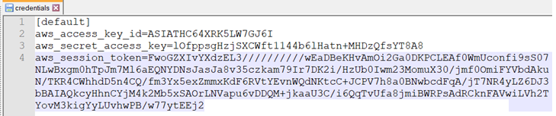
AWS Client Settings
Go to C:\Users\<--UserName-->\.aws > credentials and update credentials

Slide 6
AWS IAM Roles
capstoneDynamoRole
Permissions Policies
AWSIoTThingsRegistration
AmazonDynamoDBFullAccess
AWSIoTRuleActions
AWSLambdaBasicExecutionRole
CloudWatchApplicationInsightsFullAccess
capstoneIoTRole
Permission Policies
AWSIoTThingsRegistration
AWSIoTLogging
AmazonDynamoDBFullAccess
AWSIoTRuleActions

Slide 7
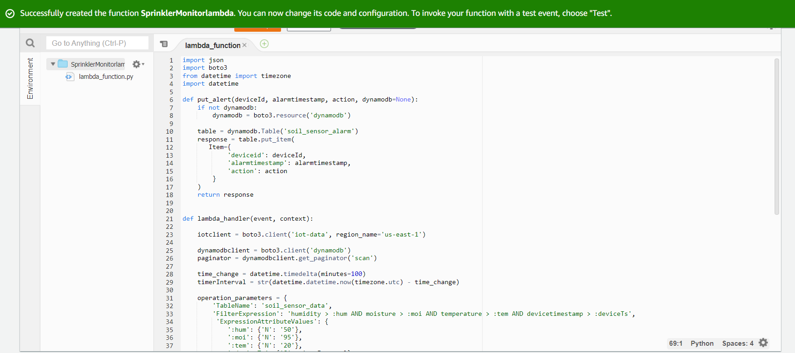
Create Lambda Function with Script : SprinklerMontiorlambda.py
Attach role to Lambda function capstoneDynamoRole
AWS lambda

Slide 8
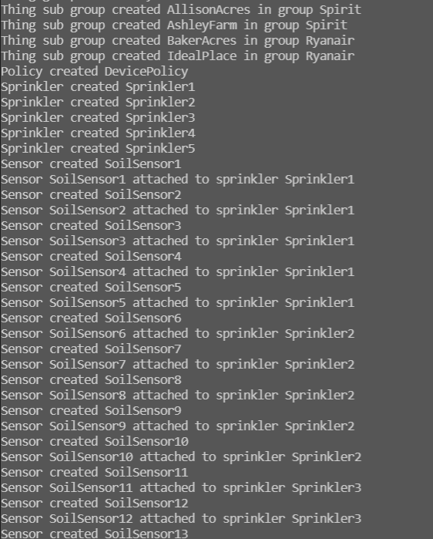
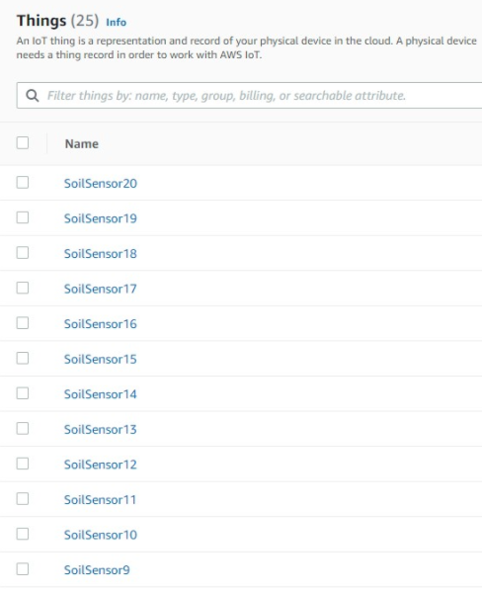

One-time Activities
Perform all one-time activities such as:
Sprinkler & Sensors
Associate Sprinkler & Sensors
Create Certificates
Rules
Script : InvokeDeviceConfiguration.py
Output Generated:
Console
AWS IoT Core

Slide 9
Farm Hierarchy
Farm hierarch is as followed
Thing Groups > Child Groups > Things & Tags
Thing Groups = Customers
Child Groups = Farms of Customer which will contain things & tags (lat,long of farm)
Example:
Ryanair > BakerAcres > SoilSensor11
Same has been depicted in the next couple of slides

Slide 10
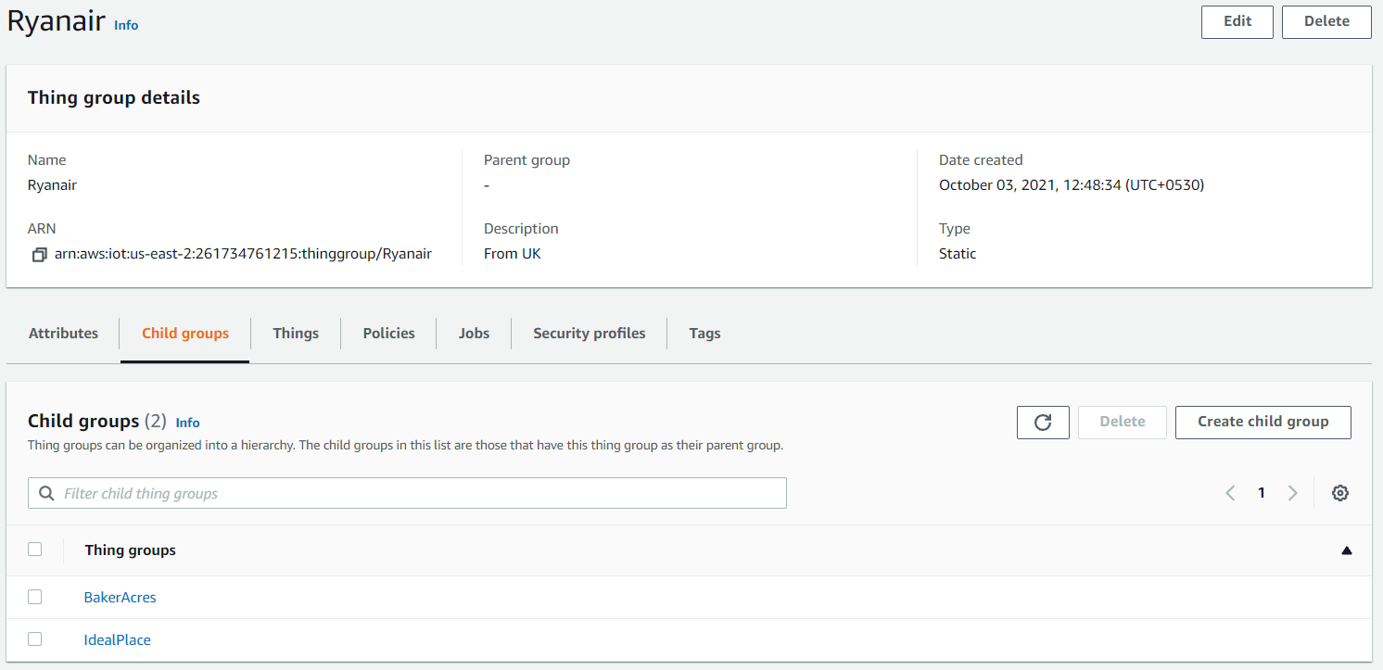
Contd..Farm Hierarchy
AWS IoT Core

Slide 11
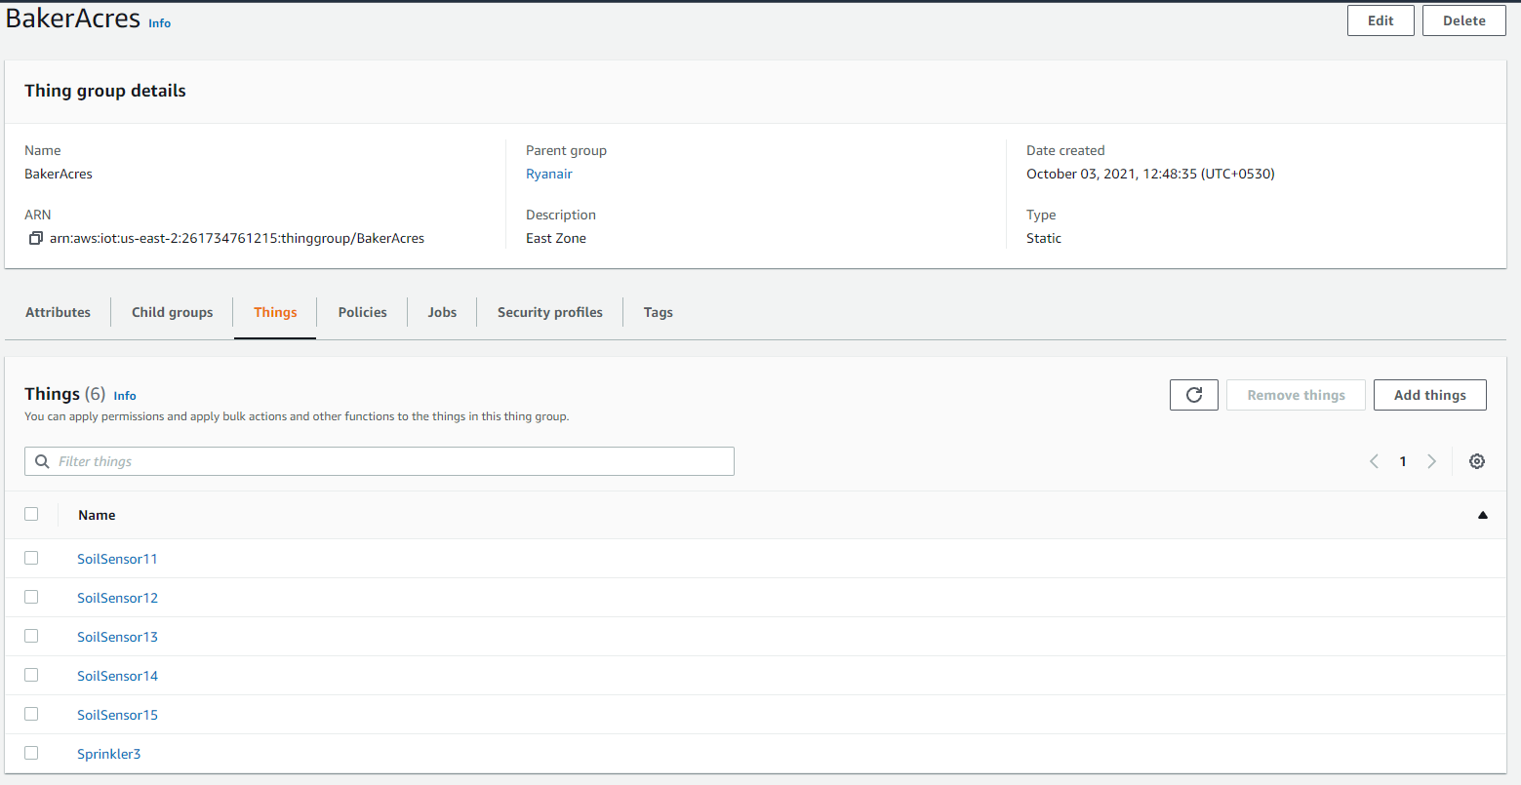
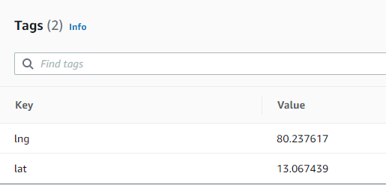
Contd..Farm Hierarchy
AWS IoT Core

Slide 12
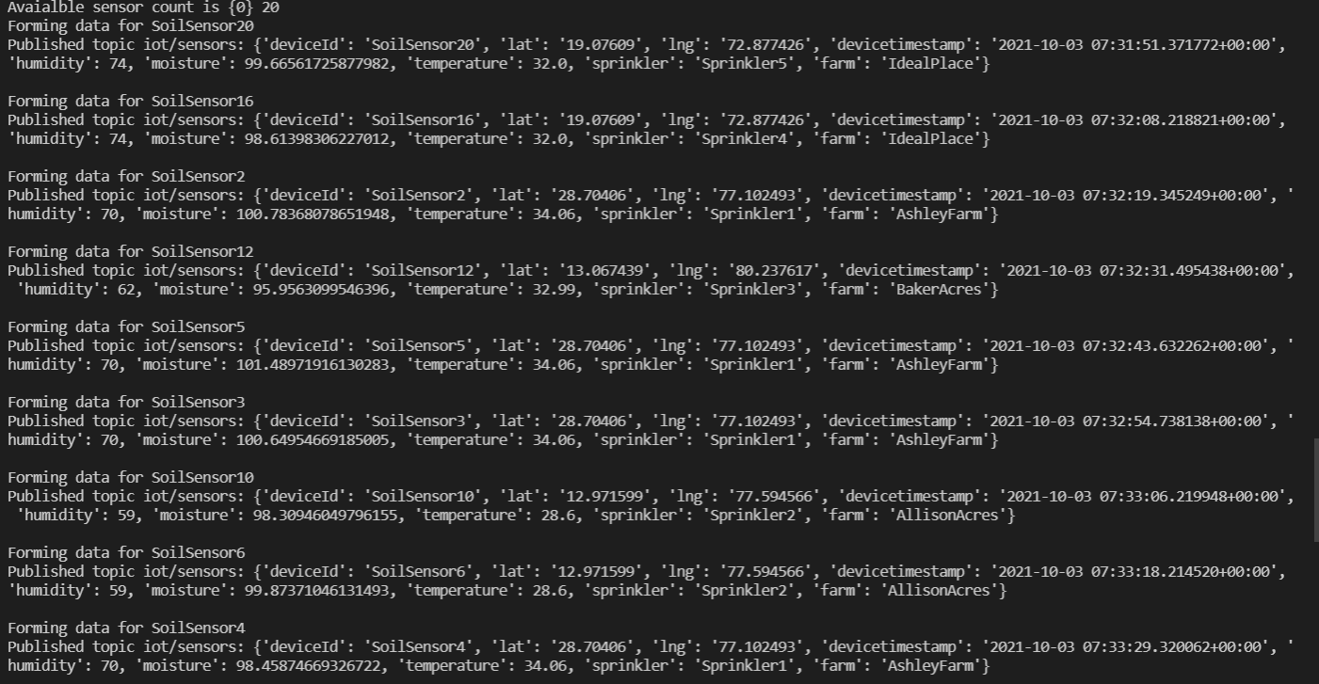
Sensor Simulator
Start pushing sensor data using sensor simulator
Script: InvokeSensorSimulator.py
Console Output

Slide 13
Lambda Invoker
Run Lambda Function using scheduler
Script: InvokeSensorSimulator.py

Slide 14
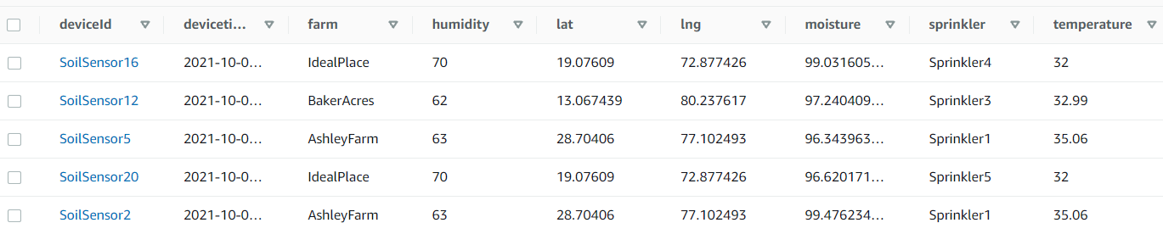

Contd.. Sensor Simulator
Data Inserted to Dynamo DB

Slide 15
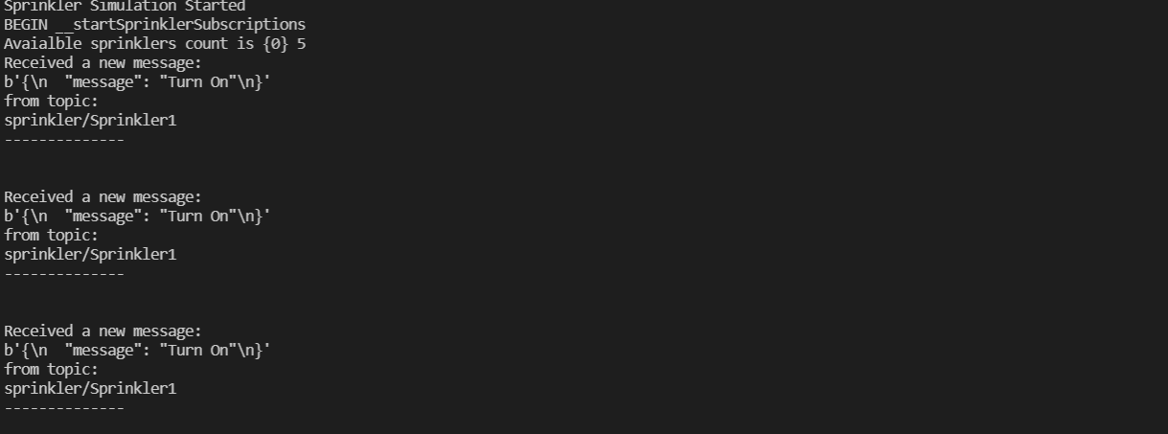
Sprinkler Simulator
Start receiving sprinkler alert
Script: InvokeSprinklerSimulator.py
Console Output

Slide 16
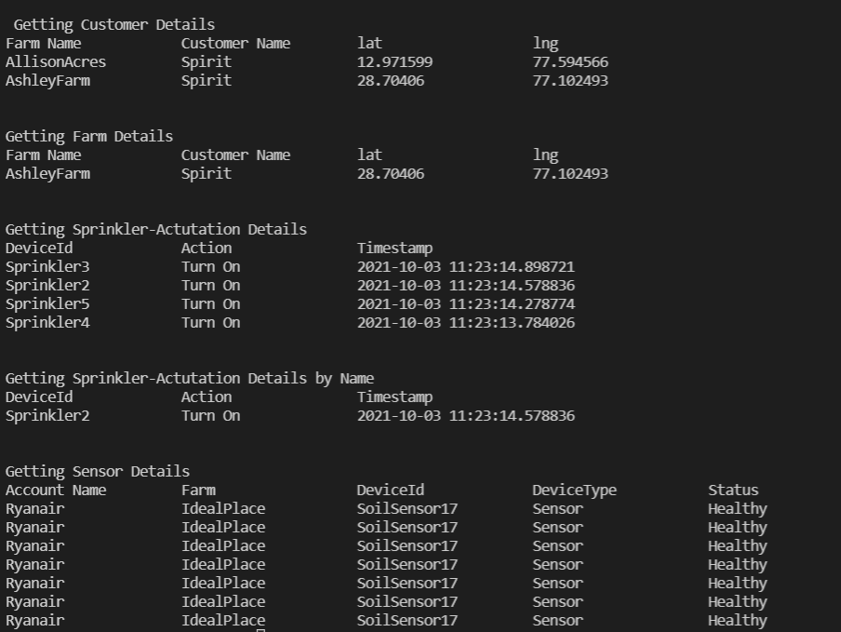
Device Dashboard
Script: InvokeDeviceDashboard.py
Console Output

